Slide 1
Digital Forensics
Room C2-17
Email: th5@Bolton.ac.uk
Tel: 01204 903558

Slide 2
Table of Contents
Digital Forensics
Rules
Process
Machines – computers, mobiles, servers
Network Forensics
In the court room
Case Study

Slide 3
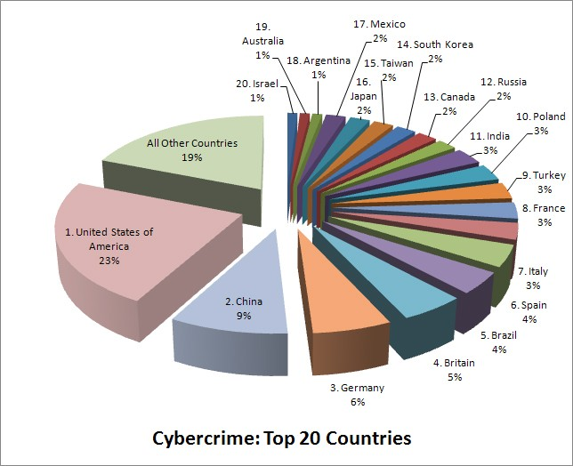
Global Cyber Crime
By Sumo3000 in Computer Security

Slide 4
Digital Forensics
Digital Forensic Science (DFS):
  “The use of scientifically derived and proven methods toward the preservation, collection, validation, identification, analysis, interpretation, documentation and presentation of digital evidence derived from digital sources for the purpose of facilitating or furthering the reconstruction of events found to be criminal or helping to anticipate unauthorized actions shown to be disruptive to planned operations.”
  Source: (2001). Digital Forensic Research Workshop (DFRWS)

Slide 5
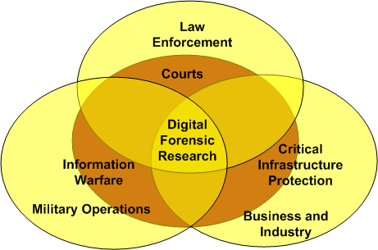
Digital Forensics
Digital Forensic Science (DFS):

Slide 6
Why we need Digital Forensic Science (DFS)?
Identify the attackers
Identify the attack methods/vulnerability of the network that allowed the attacker to gain access into the system
Conduct a destruction (impact) assessment of the victim network
Preserve the Evidence for Judicial action

Slide 7
Types of Digital Forensic
  Networks (Network Forensics)
  Small Scale Digital Devices
  Storage Media (Computer forensics)
  Code Analysis
  Computer forensic: Involves and analysing digital information
  As evidence I civil, criminal, or administrative cases.

Slide 8
Process/Phases
Identification
Collection
  Bag & Tag
Preservation
Examination
Analysis
Presentation/Report

Slide 9
Defining Computer Forensics
Collection, preservation, analysis and presentation of computer-related evidence.
Evidence might be required for a wide range of computer crimes and misuses.
Shaping the past actions that have happened on a computer system using computer forensic techniques.
Information collected assistances in arrests, prosecution, termination of employment, and preventing future illegal actions.

Slide 10
What is Digital Forensics
Computer Forensics.
Mobile Forensics.
Network Forensics.
Cloud Forensics.

Slide 11
Understand Forensics process
Identity – What needs to be investigated.
Preserve data – so its not lost or corrupted.
Extract – Information following proper legal methodology.
Analyses – The information classified and proper links between the elements are established.
Evaluation - Evaluating the information/data recovered to
determine if and how it could be used again the
suspect for employment termination or prosecution
in court
Report- present the Evidences to the court of laws.

Slide 12
Types of search
Raw Search
  A search based on keywords that search the entire drive for a match
  Slow process on larger drives
Indexed Search
  A search that requires the drive to be indexed
  Indexing can take a long time
  Searches are instantaneous

Slide 13
Details For Evidence
Acceptability of Evidence
Legal rules which determine whether potential evidence can be considered by a court
Must be obtained in a manner which ensures the legitimacy and authority and that no tampering had taken place
No possible evidence is damaged, destroyed, or otherwise compromised by the procedures used to search the computer
Avoiding viruses from being introduced to a computer during the analysis process
Extracted / relevant evidence is properly handled and protected from later mechanical
or electromagnetic damage

Slide 14
Significant things to remember
Legal procedures
  Not compromising evidence
Treat every piece of evidence as it will be used in court
Documentation*
Chain of Custody
Write Blocks
Imaging
  Bit by bit copy of a piece of electronic media (Hard drive)
Notes:
Documentation needs to be kept from beginning to end, as soon as you become involved in a case. This includes what is commonly referred to as a chain of custody form, as well as documentation pertinent to what you do during your analysis. We cannot overemphasize the importance of documentation. When involved in a situation where you are conducting a computer forensics analysis, we recommend that you establish and keep the mindset that the case or situation is going to end up in court. This will go a long way in helping you to make sure that you are keeping the appropriate documentation. Take for granted that you will be questioned on every aspect of the case, and everything that you do.

Slide 15
Evidence Processing Guidelines
New Technologies Inc. recommends sixteen steps to follow in processing evidence
They offer training on properly handling each step
  Step 1: Shut down the computer
    Considerations must be given to volatile information
    Prevents remote access to machine and destruction of evidence (manual or ant-forensic software)
  Step 2: Document the Hardware Configuration
  of The System
    Note everything about the computer configuration
    prior to re-locating

Slide 16
Evidence Processing Guidelines
  Step 3: Transport the Computer System to A Secure Location
    Do not leave the computer unattended unless it is locked in a secure location
  Step 4: Make Bit Stream Backups of Hard Disks
  Step 5: Mathematically Authenticate Data on All Storage Devices
    Must be able to prove that you did not alter
    any of the evidence after the computer
    came into your possession
  Step 6: Document the System Date and Time
  Step 7: Make a List of Key Search Words
  Step 8: Evaluate the Windows Swap File

Slide 17
Evidence Processing Guidelines
  Step 9: Evaluate File Slack
    File slack is a data storage area of which most computer users are unaware; a source of significant security leakage.
  Step 10: Evaluate Unallocated Space (Erased Files)
  Step 11: Search Files, File Slack and Unallocated Space for Key Words
  Step 12: Document File Names, Dates and Times
  Step 13: Identify File, Program and Storage Anomalies
  Step 14: Evaluate Program Functionality
  Step 15: Document Your Findings
  Step 16: Retain Copies of Software Used

Slide 18
Forensics career Path
Forensic prerequisites: basic understanding of computer hardware and software.
Common job titles:
- Cyber forensics analysis /technician.
- Digital forensic examiner.
-Incidence response analyst.
Skill learned carry in many roles:
Penetration tester, Malware analyst, Security consulting and managing,

Slide 19
Performing the Investigation
Secure evidence
Photograph evidence
Maintain chain of custody
Make the image of the device
Perform a forensic analysis on the image, not on the device itself

Slide 20
Secure the evidence
Normally, this step would be undertaken by law enforcement or the forensic investigator.
Collecting data storage devices in such a way as to avoid damaging any data they might contain.
If the system is encrypted, this action will the data not accessible, so live investigations is used when technology possible.

Slide 21
Chain of Custody
From time of collection evidences must be logged and stored securely.
Evidence log should show exactly when the evidence was accessed, and by whom.
Be specific about the evidence itself.
08/11/2019 3:30 pm.
Flash drive PD2356-04-518 a recovered from Mr Adam Smith office by security officer John Murphy and entered into evidence locker.
12/11/2019 9:00am.
Flash drive PD2356-04-518 retrieved from evidence locker by Mr John Smith for forensic analysis.

Slide 22
Secure the evidence
Always make an image first as:
investigating a device carries some risk of:
-changing any data contained on that device.
-opposing lawyer will argue that the evidence shouldn’t be admitted.
Standard procedure is to make an image of the device first then analyse the image.

Slide 23
Using the dd Command
Allows you to copy a file and change the format of the destination file
Has a rich set of options to handle copies when other methods are inappropriate such as when the format of the destination file needs to be altered. (ASCII to EBCDIC, uppercase to lowercase, etc.)
An advantage to using the dd command over cp is that all users, not just the administrator, can copy files to and from the floppy drive without mounting it.

Slide 24
Using the dd Command
Options
  if= input file
  of=output file
  conv=ascii converts destination to ascii
  conv=lcase converts uppercase to lower

Slide 25
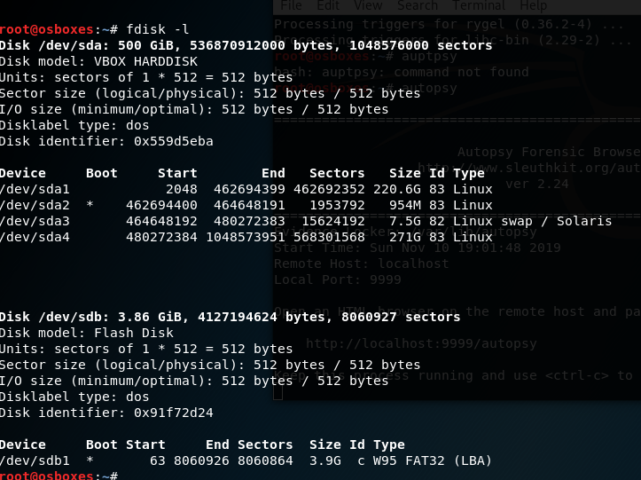
Using the fdisk –l Command
The Fdisk –l command clearly indicated that the flash stick use is:
/dev/sdb1

Slide 26
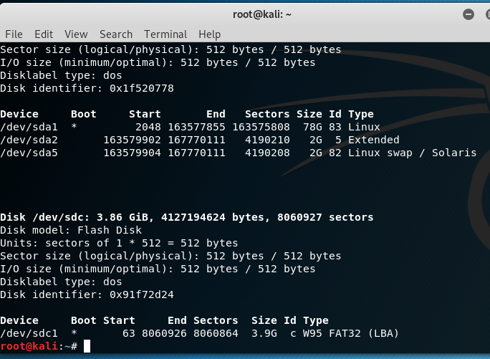
Clone and image the disks with Linux dd command
Fdisk –l
dd if=/dev/sdb of=/root/imgae1.img bs=8M
This will take long time.

Slide 27
Guymager Package Description
Guymager is a free forensic imager for media acquisition. Its main features are:
Easy user interface in different languages
Runs under Linux
Really fast, due to multi-threaded, pipelined design and multi-threaded data compression
Makes full usage of multi-processor machines
Generates flat (dd), EWF (E01) and AFF images, supports disk cloning
Free of charges, completely open source

Slide 28
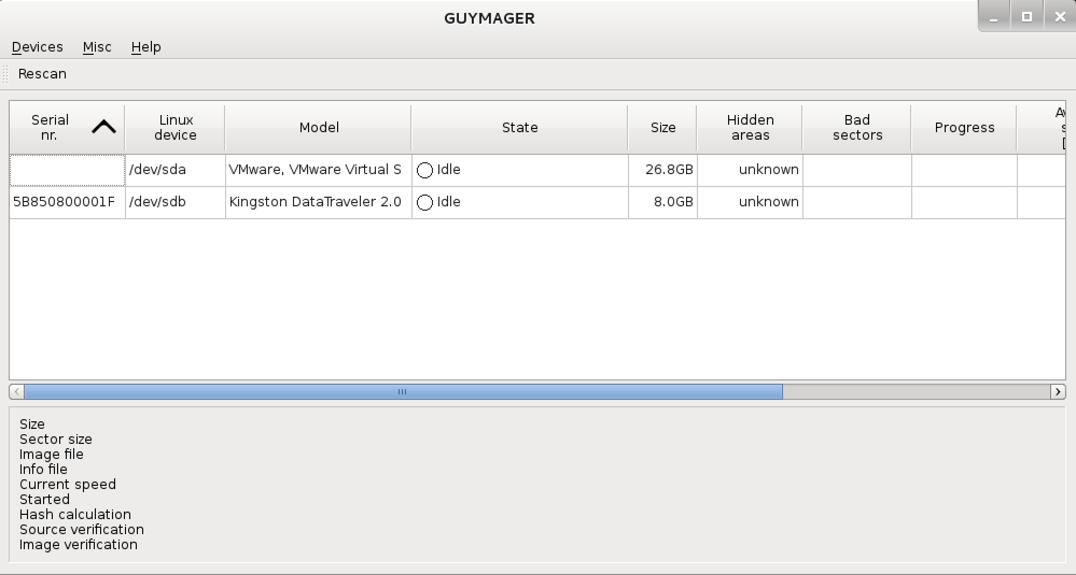
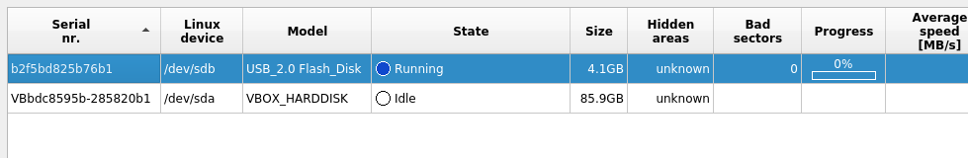
Guymager Usage Example

Slide 29
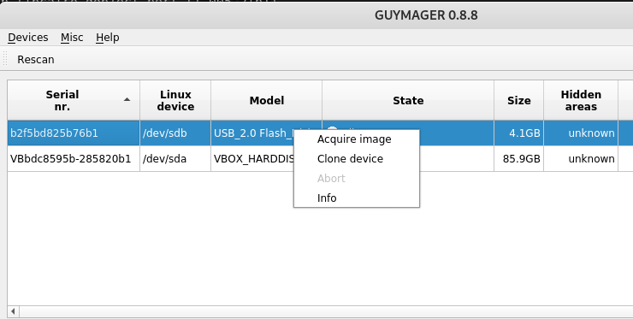
Image Acquisition
Right-click on the device you need to image. Choose “Acquire Image.” This will bring up the Acquire Image screen, shown here:

Slide 30
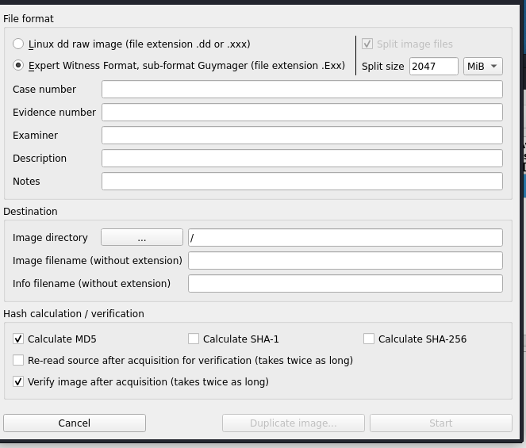
Image Acquisition
By default, you can choose Linux DD raw image file or Expert Witness Format. A third image format, Advanced Forensic Format (.aff), which can be mounted by third party tools, has been deprecated in the newer iteration of the Guymager interface.

Slide 31
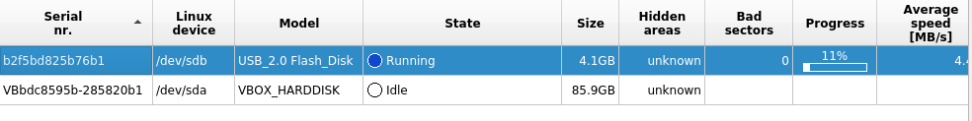
Creating a Forensic Disk Image with the Linux Guymager Utility
In this example, a USB 2.0 Flash drive is the image target. This is a very slow interface for image acquisition and may be prohibitively so for imaging large external drives. For these, USB 3.0 is preferred,and soon USB-C will be more widely adopted and will allow quicker images for devices that can use it.
When imaging is complete the acquisition screen will show Finished

Slide 32
Any Questions
?

